Slide 1
When loops go purrr (tidyverse iterations)

Slide 2
Short “quiz” Which of these are iterations?
a <- 0
while (a < 100){
a <- a+1
}
library(purrr)
map_dbl(1:100, function(a){a+1})
Base R loop
purrr iteration C++ loop
a <- 0
for (i in 1:10){
a <- a+1
}
a <- 1:100
a <- a + 1
core vector operation (C loop)
Base R loop
2 minutes

Slide 3
Why purrr? What is functional programming?
“purrr enhances R’s functional programming (FP) toolkit by providing a complete and consistent set of tools for working with functions and vectors”
purrr’s overview (https://purrr.tidyverse.org/)
What makes a programming language “functional”?
Functions behave like any other data structure (e.g. you can “pass them” as a variable)
Functions are pure
Output depends only on input (consistent), i.e., runif(), read_csv(), Sys.time() are not pure
No side-effects (e.g., not changing global variables or writing to a file)
Hence, R is not entirely “functional” but adopts some elements

Slide 4
A functional
Functional is a function that takes a function as an input and returns a vector as an output (like in math), e.g.:
randomize <- function(f) f(runif(1e3))
randomize(mean)
randomize(sd)
randomize(plot)
integrate(sin, lower = 0, upper = pi/2)
map, lapply, apply,…

Slide 5
Be specific
As a “best practice”, when you are using iterations, you should be as specific as possible, and pre-allocate as much as possible.
In other words your preference should be:
purrr > for > while > repeat

Slide 6
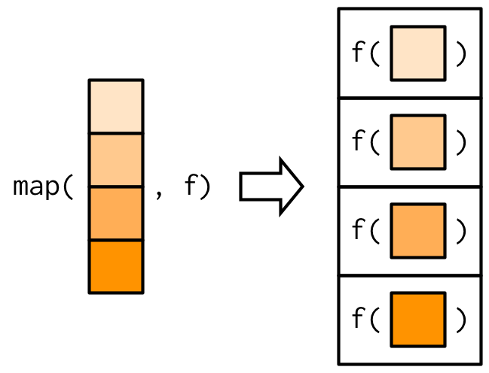
purrr::map
Takes a vector and a function and does this:
The implementation is in C code,
but is equivalent logically to something like:
simple_map <- function(x, f, ...) { out <- vector("list", length(x)) for (i in seq_along(x)) { out[[i]] <- f(x[[i]], ...) } out }
map() returns a list, map_dbl(), map_lgl(), map_int(), map_chr() return a vecor of type double, logical, integer, and character.

Slide 7
Functions in the purrr family
map
Objects that you can get
walk
map_chr
map2
Can iterate on objects of varying size
purrr
Return a…
map_lgl
map_dbl
pmap
By defining a function like:
map_df
map_int
function(x) x
~ .x
map
my_func <- function(x) {x}

Slide 8
A moment to think, in pairs
When you run map(iris, mean) what would you get?
What would you get with map_dbl(iris, mean)
Explain the output using the “equivalent loop”:
simple_map <- function(x, f, ...) { out <- vector("list", length(x)) for (i in seq_along(x)) { out[[i]] <- f(x[[i]], ...) } out }
4 minutes

Slide 9
Defining functions for the use of map/map_*
Inline anonymous function:
map_dbl(iris, function(x) length(unique(x)))
Formula ~ shortcut
map_dbl(iris, ~length(unique(.x)))
Or define it then use it:
my_func <- function(x) { length(unique(x)) }
map_dbl(iris, my_func)

Slide 10
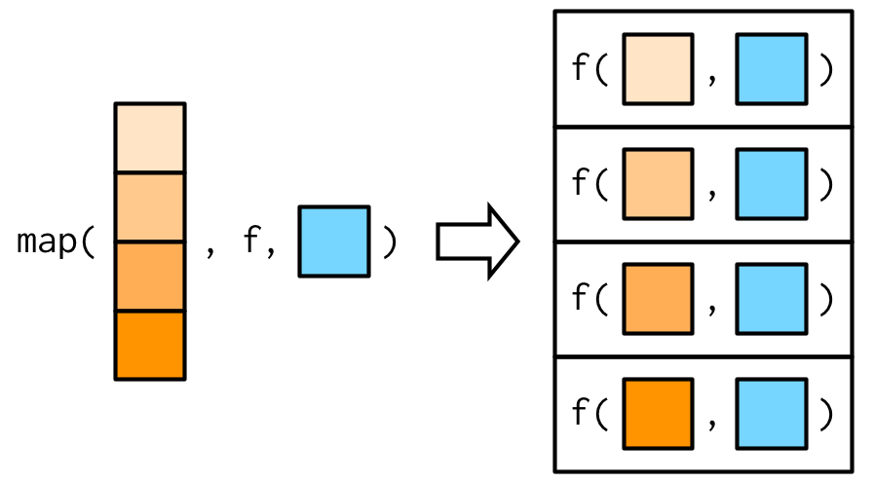
Passing additional arguments to map
x <- list(1:5, c(1:10, NA))
Using an inline function:
map_dbl(x, ~ mean(.x, na.rm = TRUE))
Map also passes the ..., so you can just keep on specifying:
map_dbl(x, mean, na.rm = TRUE)

Slide 11
Exercise (question 1) (code available at 06-Purrr.R)
Explain the differences between the following four code segments. Explain what happens in each:
iris %>%
group_by(Species) %>%
map_dbl(length)
iris %>%
group_by(Species) %>%
nest() %>%
mutate(mean1 = map_int(data, length))
iris %>%
group_by(Species) %>%
nest() %>%
mutate(mean2 = map_int(data, NROW))
iris %>%
group_by(Species) %>%
nest() %>%
mutate(lm = map(data, function(df) lm(data = df, Sepal.Length ~ .)))

Slide 12
Exercise (question 2) (code available at 06-Purrr.R)
Reading multiple files using map and extracting information out of them, using map_*

Slide 13
Exercise (question 3) (code available at 06-Purrr.R)
Using walk to get the function’s side effect.

